Slide 1
HTML Advanced Tags

Slide 2
HTML Block and Inline Elements
Every HTML element has a default display value, depending on what type of element it is.
There are two display values: block and inline.

Slide 3
Block-level Elements
A block-level element always starts on a new line, and the browsers automatically add some space (a margin) before and after the element.
A block-level element always takes up the full width available (stretches out to the left and right as far as it can).
Two commonly used block elements are: <p> and <div>.
The <p> element defines a paragraph in an HTML document.
The <div> element defines a division or a section in an HTML document.
The <p> element is a block-level element.
The <div> element is a block-level element.

Slide 4
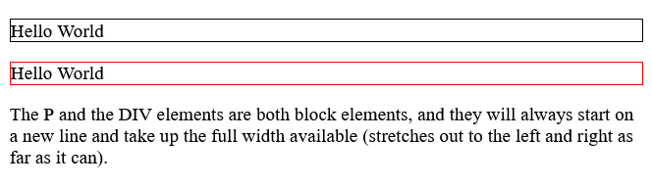
<!DOCTYPE html>
<html>
<body>
<p style="border: 1px solid black">Hello World</p>
<div style="border: 1px solid red">Hello World</div>
<p>The P and the DIV elements are both block elements, and they will always start on a new line and take up the full width available (stretches out to the left and right as far as it can).</p>
</body>
</html>

Slide 5
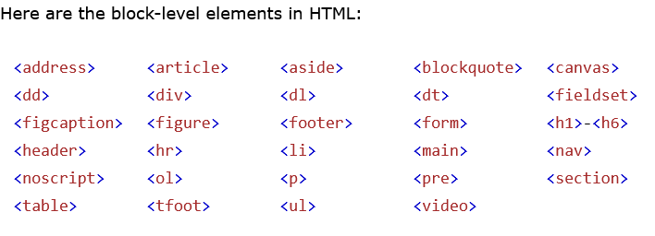

Slide 6
Inline Elements
An inline element does not start on a new line.
An inline element only takes up as much width as necessary.
Note: An inline element cannot contain a block-level element!

Slide 7
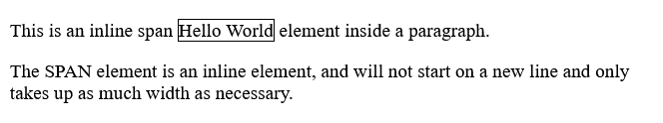
<!DOCTYPE html>
<html>
<body>
<p>This is an inline span <span style="border: 1px solid black">Hello World</span> element inside a paragraph.</p>
<p>The SPAN element is an inline element, and will not start on a new line and only takes up as much width as necessary.</p>
</body>
</html>

Slide 8
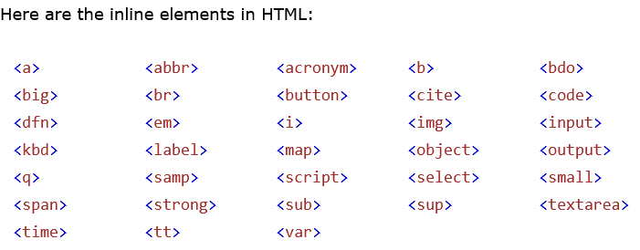

Slide 9
HTML class Attribute
The HTML class attribute is used to specify a class for an HTML element.
Multiple HTML elements can share the same class.
Using The class Attribute
The class attribute is often used to point to a class name in a style sheet. It can also be used by a JavaScript to access and manipulate elements with the specific class name.
In the following example we have three <div> elements with a class attribute with the value of "city". All of the three <div> elements will be styled equally according to the .city style definition in the head section:

Slide 10
<!DOCTYPE html>
<html>
<head>
<style>
.city {
background-color: tomato;
color: white;
border: 2px solid black;
margin: 20px;
padding: 20px;
}
</style>
</head>
<body>
<div class="city">
<h2>London</h2>
<p>London is the capital of England.</p>
</div>

Slide 11
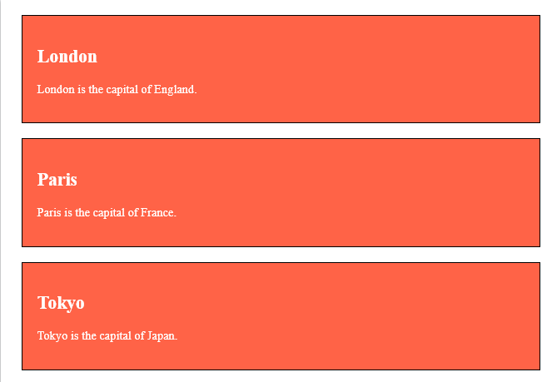
<div class="city">
<h2>Paris</h2>
<p>Paris is the capital of France.</p>
</div>
<div class="city">
<h2>Tokyo</h2>
<p>Tokyo is the capital of Japan.</p>
</div>
</body>
</html>

Slide 12
Tip: The class attribute can be used on any HTML element.
Note: The class name is case sensitive!

Slide 13
HTML id Attribute
The HTML id attribute is used to specify a unique id for an HTML element.
You cannot have more than one element with the same id in an HTML document.
Using The id Attribute
The id attribute specifies a unique id for an HTML element. The value of the id attribute must be unique within the HTML document.
The id attribute is used to point to a specific style declaration in a style sheet. It is also used by JavaScript to access and manipulate the element with the specific id.

Slide 14
The syntax for id is: write a hash character (#), followed by an id name. Then, define the CSS properties within curly braces {}.
In the following example we have an <h1> element that points to the id name "myHeader". This <h1> element will be styled according to the #myHeader style definition in the head section

Slide 15
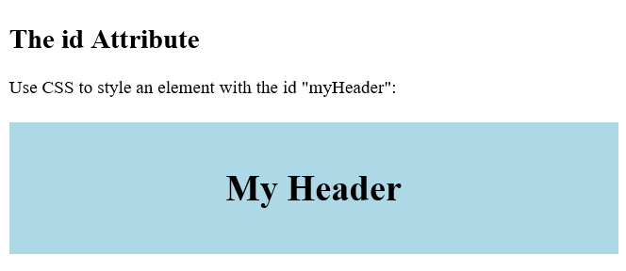
<!DOCTYPE html>
<html>
<head>
<style>
#myHeader {
background-color: lightblue;
color: black;
padding: 40px;
text-align: center;
}
</style>
</head>
<body>
<h2>The id Attribute</h2>
<p>Use CSS to style an element with the id "myHeader":</p>
<h1 id="myHeader">My Header</h1>
</body>
</html>

Slide 16
Note: The id name is case sensitive!
Note: The id name must contain at least one character, cannot start with a number, and must not contain whitespaces (spaces, tabs, etc.).

Slide 17
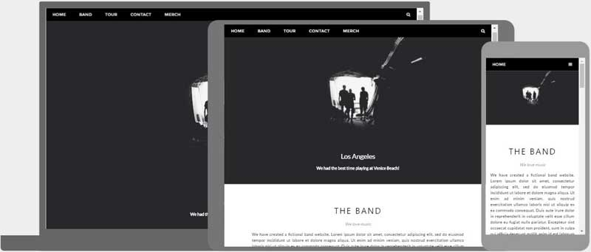
HTML Responsive Web Design
Responsive web design is about creating web pages that look good on all devices!
A responsive web design will automatically adjust for different screen sizes and viewports.

Slide 18
Setting The Viewport
To create a responsive website, add the following <meta> tag to all your web pages:
Example
<meta name="viewport" content="width=device-width, initial-scale=1.0">

Slide 19
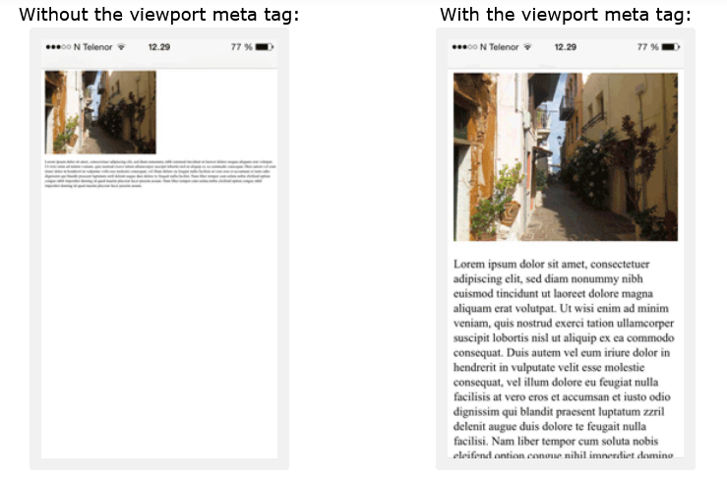
This will set the viewport of your page, which will give the browser instructions on how to control the page's dimensions and scaling.
Here is an example of a web page without the viewport meta tag, and the same web page with the viewport meta tag:

Slide 20
Responsive Images
Responsive images are images that scale nicely to fit any browser size.
Using the width Property
If the CSS width property is set to 100%, the image will be responsive and scale up and down

Slide 21
<!DOCTYPE html>
<html>
<head>
<meta name="viewport" content="width=device-width, initial-scale=1.0">
</head>
<body>
<h2>Responsive Image</h2>
<p>When the CSS width property is set in a percentage value, the image will scale up and down when resizing the browser window. Resize the browser window to see the effect.</p>
<img src="img_girl.jpg" style="width:100%;">
</body>
</html>

Slide 22
In the example above, the image can be scaled up to be larger than its original size. A better solution, in many cases, will be to use the max-width property instead.
Using the max-width Property
If the max-width property is set to 100%, the image will scale down if it has to, but never scale up to be larger than its original size
<img src="img_girl.jpg" style="max-width:100%;height:auto;">

Slide 23
Show Different Images Depending on Browser Width
The HTML <picture> element allows you to define different images for different browser window sizes.
Resize the browser window to see how the image below changes depending on the width

Slide 24
<!DOCTYPE html>
<html>
<head>
<meta name="viewport" content="width=device-width, initial-scale=1.0">
</head>
<body>
<h2>Show Different Images Depending on Browser Width</h2>
<p>Resize the browser width and the image will change at 600px and 1500px.</p>

Slide 25
<picture>
<source srcset="img_smallflower.jpg" media="(max-width: 600px)">
<source srcset="img_flowers.jpg" media="(max-width: 1500px)">
<source srcset="flowers.jpg">
<img src="img_flowers.jpg" alt="Flowers" style="width:auto;">
</picture>
</body>
</html>

Slide 26
Responsive Text Size
The text size can be set with a "vw" unit, which means the "viewport width".
That way the text size will follow the size of the browser window
Example
<h1 style="font-size:10vw">Hello World</h1>
Viewport is the browser window size. 1vw = 1% of viewport width. If the viewport is 50cm wide, 1vw is 0.5cm.

Slide 27
Media Queries
In addition to resize text and images, it is also common to use media queries in responsive web pages.
With media queries you can define completely different styles for different browser sizes.
Example: resize the browser window to see that the three div elements will display horizontally on large screens and stack vertically on small screens

Slide 28
<style>
.left, .right {
float: left;
width: 20%; /* The width is 20%, by default */
}
.main {
float: left;
width: 60%; /* The width is 60%, by default */
}
/* Use a media query to add a breakpoint at 800px: */
@media screen and (max-width: 800px) {
.left, .main, .right {
width: 100%; /* The width is 100%, when the viewport is 800px or smaller */
}
}
</style>

Slide 29
HTML Semantic Elements
A semantic element clearly describes its meaning to both the browser and the developer.
Examples of non-semantic elements: <div> and <span> - Tells nothing about its content.
Examples of semantic elements: <form>, <table>, and <article> - Clearly defines its content.

Slide 30
Many web sites contain HTML code like: <div id="nav"> <div class="header"> <div id="footer"> to indicate navigation, header, and footer.
In HTML there are some semantic elements that can be used to define different parts of a web page

Slide 31
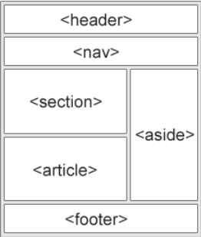

Slide 32
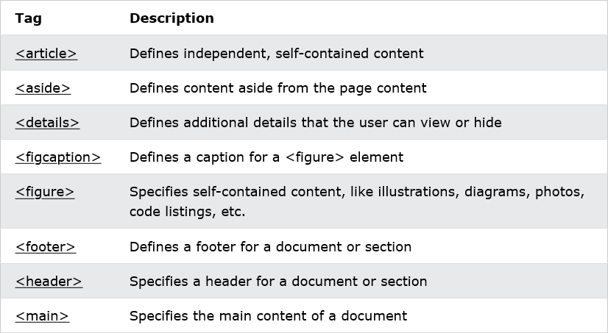
Semantic Elements in HTML

Slide 33
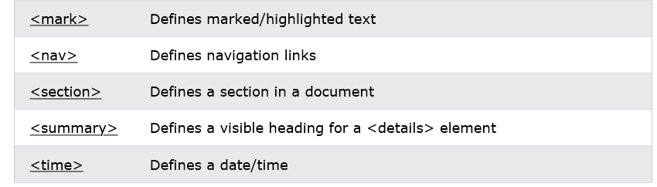

Slide 34
HTML Entities
Some characters are reserved in HTML.
If you use the less than (<) or greater than (>) signs in your text, the browser might mix them with tags.
Character entities are used to display reserved characters in HTML.
A character entity looks like this:
&entity_name;
OR
&#entity_number;
To display a less than sign (<) we must write: &lt; or &#60;

Slide 35
Advantage of using an entity name: An entity name is easy to remember.
Disadvantage of using an entity name: Browsers may not support all entity names, but the support for entity numbers is good.

Slide 36
Non-breaking Space
A commonly used entity in HTML is the non-breaking space: &nbsp;
A non-breaking space is a space that will not break into a new line.
Two words separated by a non-breaking space will stick together (not break into a new line). This is handy when breaking the words might be disruptive.
Examples:
§ 10
10 km/h
10 PM

Slide 37
Another common use of the non-breaking space is to prevent browsers from truncating spaces in HTML pages.
If you write 10 spaces in your text, the browser will remove 9 of them. To add real spaces to your text, you can use the &nbsp; character entity.
Tip: The non-breaking hyphen (&#8209;) is used to define a hyphen character (‑) that does not break into a new line.
Note: Entity names are case sensitive.

Slide 38
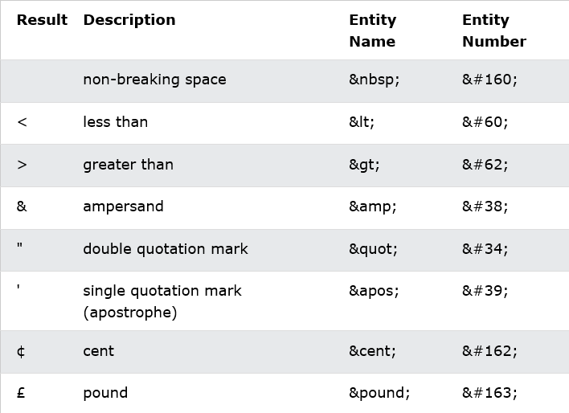
Some Useful HTML Character Entities

Slide 39
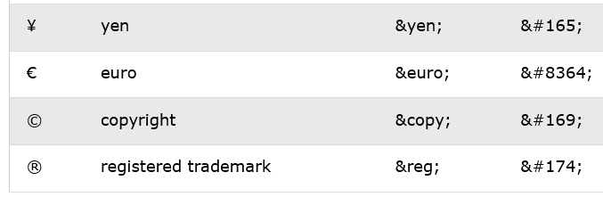

Slide 40
HTML Symbols
Many mathematical, technical, and currency symbols, are not present on a normal keyboard.
To add such symbols to an HTML page, you can use the entity name or the entity number (a decimal or a hexadecimal reference) for the symbol.
Example
Display the euro sign, €, with an entity name, a decimal, and a hexadecimal value:
<p>I will display &euro;</p>
<p>I will display &#8364;</p>
<p>I will display &#x20AC;</p>
Will display as:
I will display €
I will display €
I will display €

Slide 41
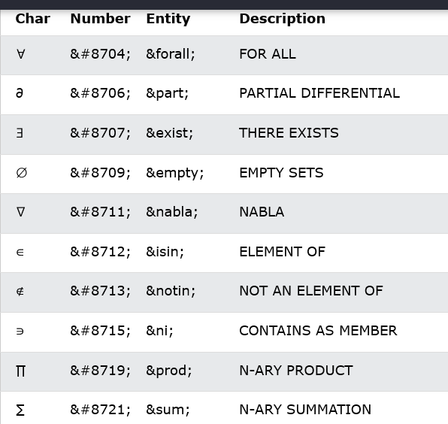
Some Mathematical Symbols Supported by HTML

Slide 42
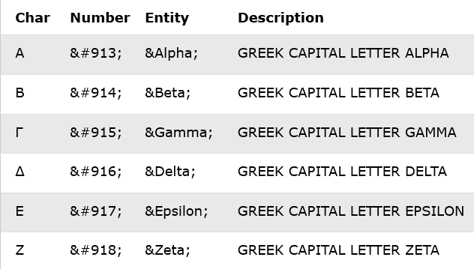
Some Greek Letters Supported by HTML

Slide 43
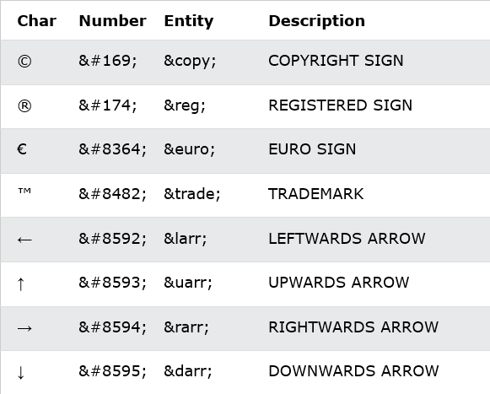
Some Other Entities Supported by HTML

Slide 44
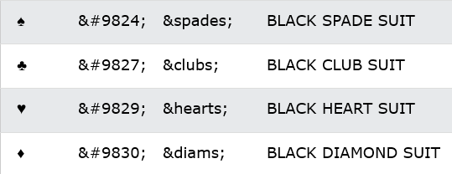

Slide 45
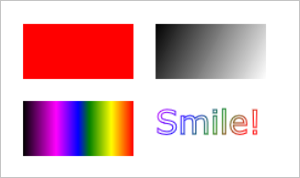
HTML Canvas Graphics
The HTML <canvas> element is used to draw graphics on a web page.
The graphic below is created with <canvas>. It shows four elements: a red rectangle, a gradient rectangle, a multicolor rectangle, and a multicolor text.

Slide 46
The HTML <canvas> element is used to draw graphics, on the fly, via JavaScript.
The <canvas> element is only a container for graphics. You must use JavaScript to actually draw the graphics.
Canvas has several methods for drawing paths, boxes, circles, text, and adding images.

Slide 47
Canvas Examples
A canvas is a rectangular area on an HTML page. By default, a canvas has no border and no content.
The markup looks like this:
<canvas id="myCanvas" width="200" height="100"></canvas>
Note: Always specify an id attribute (to be referred to in a script), and a width and height attribute to define the size of the canvas. To add a border, use the style attribute.
Here is an example of a basic, empty canvas:

Slide 48
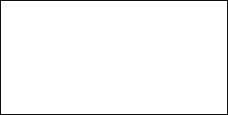
<!DOCTYPE html>
<html>
<body>
<canvas id="myCanvas" width="200" height="100" style="border:1px solid #000000;">
Your browser does not support the HTML canvas tag.
</canvas>
</body>
</html>

Slide 49
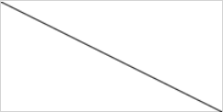
Add a JavaScript
After creating the rectangular canvas area, you must add a JavaScript to do the drawing.
Here are some examples:
Draw a Line

Slide 50
<!DOCTYPE html>
<html>
<body>
<canvas id="myCanvas" width="200" height="100" style="border:1px solid #d3d3d3;">
Your browser does not support the HTML canvas tag.</canvas>

Slide 51
<script>
var c = document.getElementById("myCanvas");
var ctx = c.getContext("2d");
ctx.moveTo(0,0);
ctx.lineTo(200,100);
ctx.stroke();
</script>
</body>
</html>

Slide 52
Draw a Circle
<!DOCTYPE html>
<html>
<body>
<canvas id="myCanvas" width="200" height="100" style="border:1px solid #d3d3d3;">
Your browser does not support the HTML canvas tag.</canvas>

Slide 53
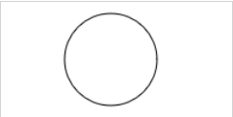
<script>
var c = document.getElementById("myCanvas");
var ctx = c.getContext("2d");
ctx.beginPath();
ctx.arc(95,50,40,0,2*Math.PI);
ctx.stroke();
</script>
</body>
</html>

Slide 54
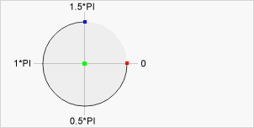
The arc() method adds an arc (curve) to the path.
The arc() method creates a circle or a part of a circle.
Use the stroke() or fill() method to draw the path.

Slide 55
Center: arc(100, 75, 50, 0 * Math.PI, 1.5 * Math.PI)
Start angle: arc(100, 75, 50, 0, 1.5 * Math.PI)
End angle: arc(100, 75, 50, 0 * Math.PI, 1.5 * Math.PI)
Note
To create a circle: Set start angle to 0 and end angle to 2*Math.PI.
To create half a circle: Set start angle to 0 and end angle to Math.PI.

Slide 56
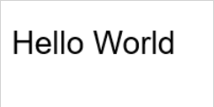
Draw a Text
<script>
var c = document.getElementById("myCanvas");
var ctx = c.getContext("2d");
ctx.font = "30px Arial";
ctx.fillText("Hello World", 10, 50);
</script>

Slide 57

Stroke Text
<script>
var c = document.getElementById("myCanvas");
var ctx = c.getContext("2d");
ctx.font = "30px Arial";
ctx.strokeText("Hello World", 10, 50);
</script>

Slide 58
text -The text to write on the canvas
x - The x coordinate to start the text
y - The y coordinate to start the text
maxWidth (Optional) - The maximum text width in pixels

Slide 59

Draw Linear Gradient
<script>
var c = document.getElementById("myCanvas");
var ctx = c.getContext("2d");
// Create gradient
var grd = ctx.createLinearGradient(0, 0, 200, 0);
grd.addColorStop(0, "red");
grd.addColorStop(1, "white");
// Fill with gradient
ctx.fillStyle = grd;
ctx.fillRect(10, 10, 150, 80);
</script>

Slide 60
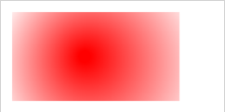
Draw Circular Gradient
<script>
var c = document.getElementById("myCanvas");
var ctx = c.getContext("2d");
// Create gradient
var grd = ctx.createRadialGradient(75, 50, 5, 90, 60, 100);
grd.addColorStop(0, "red");
grd.addColorStop(1, "white");
// Fill with gradient
ctx.fillStyle = grd;
ctx.fillRect(10, 10, 150, 80);
</script>

Slide 61
context.createLinearGradient(x0, y0, x1, y1)
x0 - The x-coordinate of the start point of the gradient
y0 - The y-coordinate of the start point of the gradient
x1 - The x-coordinate of the end point of the gradient
y1 - The y-coordinate of the end point of the gradient
context.fillRect(x, y, width, height)
The fillRect() method draws a "filled" rectangle.
The fillRect() method does not change the current path.
The default fillStyle is #000000 (solid black).
The fillRect() method draws a rectangle with a top-left corner at position 10,10. The rectangle is 150 pixel wide and 80 pixels high.
x - The x-coordinate of the upper-left corner of the rectangle
y - The y-coordinate of the upper-left corner of the rectangle
width - The width of the rectangle, in pixels
height -The height of the rectangle, in pixels

Slide 62
context.createRadialGradient(x0, y0, r0, x1, y1, r1)
x0 - The x-coordinate of the starting circle of the gradient
y0 - The y-coordinate of the starting circle of the gradient
r0 - The radius of the starting circle
x1 - The x-coordinate of the ending circle of the gradient
y1 - The y-coordinate of the ending circle of the gradient
r1 - The radius of the ending circle
gradient.addColorStop(stop, color)
stop - A value between 0 and 1. The position between gradian start and end
color - A CSS color value to display at the stop position

Slide 63
HTML SVG Graphics
SVG defines vector-based graphics in XML format.
SVG stands for Scalable Vector Graphics
SVG is used to define graphics for the Web
SVG is a W3C recommendation
The HTML <svg> element is a container for SVG graphics.
SVG has several methods for drawing paths, boxes, circles, text, and graphic images.

Slide 64
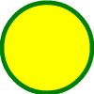
SVG Circle
<!DOCTYPE html>
<html>
<body>
<svg width="100" height="100">
<circle cx="50" cy="50" r="40"
stroke="green" stroke-width="4" fill="yellow" />
Sorry, your browser does not support inline SVG.
</svg>
</body>
</html>

Slide 65
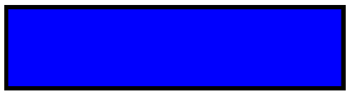
SVG Rectangle
<svg width="400" height="100">
<rect width="400" height="100" style="fill:rgb(0,0,255);stroke-width:10;stroke:rgb(0,0,0)" />
</svg>

Slide 66
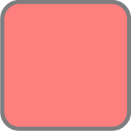
SVG Rounded Rectangle
<svg width="400" height="180">
<rect x="50" y="20" rx="20" ry="20" width="150" height="150"
style="fill:red;stroke:black;stroke-width:5;opacity:0.5" />
</svg>

Slide 67

SVG Star
<svg width="300" height="200">
<polygon points="100,10 40,198 190,78 10,78 160,198"
style="fill:lime;stroke:purple;stroke-width:5;fill-rule:evenodd;" />
</svg>

Slide 68

SVG Logo
<svg height="130" width="500">
<defs>
<linearGradient id="grad1" x1="0%" y1="0%" x2="100%" y2="0%">
<stop offset="0%" style="stop-color:rgb(255,255,0);stop-opacity:1" />
<stop offset="100%" style="stop-color:rgb(255,0,0);stop-opacity:1" />
</linearGradient>
</defs>
Notes:
The <defs> element is used to store graphical objects that will be used at a later time.
The <linearGradient> element lets authors define linear gradients to apply to other SVG elements.

Slide 69
<ellipse cx="100" cy="70" rx="85" ry="55" fill="url(#grad1)" />
<text fill="#ffffff" font-size="45" font-family="Verdana" x="50" y="86">SVG</text>
Sorry, your browser does not support inline SVG.
</svg>

Slide 70
Differences Between SVG and Canvas
SVG is a language for describing 2D graphics in XML.
Canvas draws 2D graphics, on the fly (with a JavaScript).
SVG is XML based, which means that every element is available within the SVG DOM. You can attach JavaScript event handlers for an element.
In SVG, each drawn shape is remembered as an object. If attributes of an SVG object are changed, the browser can automatically re-render the shape.
Canvas is rendered pixel by pixel. In canvas, once the graphic is drawn, it is forgotten by the browser. If its position should be changed, the entire scene needs to be redrawn, including any objects that might have been covered by the graphic.

Slide 71
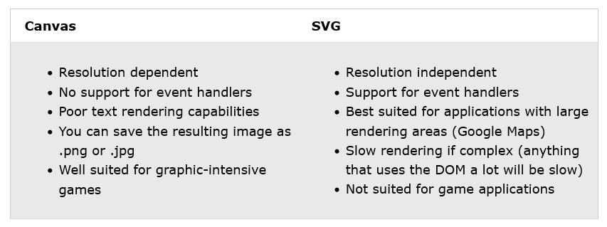
Comparison of Canvas and SVG

Slide 72
HTML Multimedia
Multimedia on the web is sound, music, videos, movies, and animations.
Multimedia comes in many different formats. It can be almost anything you can hear or see, like images, music, sound, videos, records, films, animations, and more.
Web pages often contain multimedia elements of different types and formats.

Slide 73
Multimedia Formats
Multimedia elements (like audio or video) are stored in media files.
The most common way to discover the type of a file, is to look at the file extension.
Multimedia files have formats and different extensions like: .wav, .mp3, .mp4, .mpg, .wmv, and .avi.

Slide 74
HTML Video
The HTML <video> element is used to show a video on a web page.
<!DOCTYPE html>
<html>
<body>
<video width="320" height="240" controls>
<source src="movie.mp4" type="video/mp4">
<source src="movie.ogg" type="video/ogg">
Your browser does not support the video tag.
</video>
</body>
</html>

Slide 75
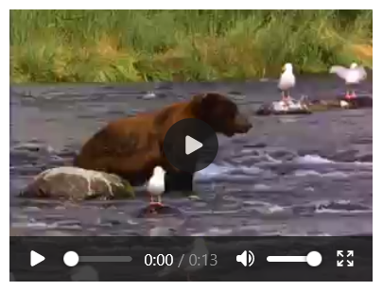
The controls attribute adds video controls, like play, pause, and volume.
It is a good idea to always include width and height attributes. If height and width are not set, the page might flicker while the video loads.
The <source> element allows you to specify alternative video files which the browser may choose from. The browser will use the first recognized format.
The text between the <video> and </video> tags will only be displayed in browsers that do not support the <video> element.

Slide 76
HTML <video> Autoplay
To start a video automatically, use the autoplay attribute:
Example
<video width="320" height="240" autoplay>
<source src="movie.mp4" type="video/mp4">
<source src="movie.ogg" type="video/ogg">
Your browser does not support the video tag.
</video>
Note: Chromium browsers do not allow autoplay in most cases. However, muted autoplay is always allowed.
Notes:
Google developers take the Chromium source code and add their proprietary code – thus resulting in Chrome which has more features and add-ons than Chromium.

Slide 77
<video width="320" height="240" autoplay muted>
<source src="movie.mp4" type="video/mp4">
<source src="movie.ogg" type="video/ogg">
Your browser does not support the video tag.
</video>
Add muted after autoplay to let your video start playing automatically (but muted)

Slide 78
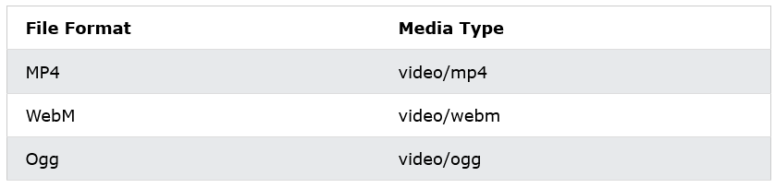
HTML Video - Media Types

Slide 79
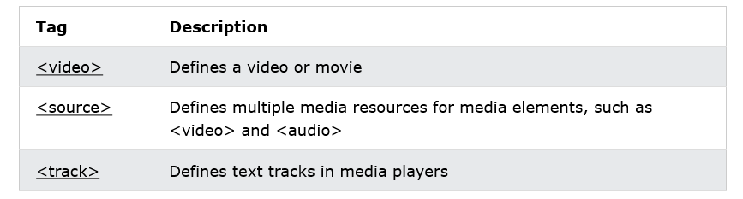
HTML Video Tags

Slide 80
HTML Audio
The HTML <audio> element is used to play an audio file on a web page.
To play an audio file in HTML, use the <audio> element

Slide 81

<!DOCTYPE html>
<html>
<body>
<audio controls>
<source src="horse.ogg" type="audio/ogg">
<source src="horse.mp3" type="audio/mpeg">
Your browser does not support the audio element.
</audio>
</body>
</html>

Slide 82
HTML Audio - How It Works
The controls attribute adds audio controls, like play, pause, and volume.
The <source> element allows you to specify alternative audio files which the browser may choose from. The browser will use the first recognized format.
The text between the <audio> and </audio> tags will only be displayed in browsers that do not support the <audio> element.

Slide 83
HTML <audio> Autoplay
To start an audio file automatically, use the autoplay attribute:
Example
<audio controls autoplay>
<source src="horse.ogg" type="audio/ogg">
<source src="horse.mp3" type="audio/mpeg">
Your browser does not support the audio element.
</audio>

Slide 84
Note: Chromium browsers do not allow autoplay in most cases. However, muted autoplay is always allowed.
Add muted after autoplay to let your audio file start playing automatically (but muted)
<audio controls autoplay muted>
<source src="horse.ogg" type="audio/ogg">
<source src="horse.mp3" type="audio/mpeg">
Your browser does not support the audio element.
</audio>

Slide 85
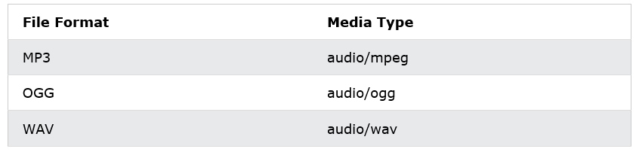
HTML Audio - Media Types

Slide 86
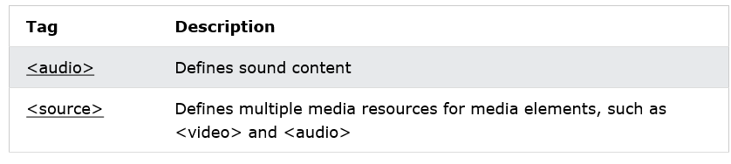
HTML Audio Tags

Slide 87
HTML Geolocation API
The HTML Geolocation API is used to locate a user's position.
The HTML Geolocation API is used to get the geographical position of a user.
Since this can compromise privacy, the position is not available unless the user approves it.
Note: Geolocation is most accurate for devices with GPS, like smartphones.
Note: As of Chrome 50, the Geolocation API will only work on secure contexts such as HTTPS. If your site is hosted on an non-secure origin (such as HTTP) the requests to get the users location will no longer function.

Slide 88
Using HTML Geolocation
The getCurrentPosition() method is used to return the user's position.
The example below returns the latitude and longitude of the user's position

Slide 89
<!DOCTYPE html>
<html>
<body>
<p>Click the button to get your coordinates.</p>
<button onclick="getLocation()">Try It</button>
<p id="demo"></p>
<script>
var x = document.getElementById("demo");
function getLocation() {
if (navigator.geolocation) {
navigator.geolocation.getCurrentPosition(showPosition);
}

Slide 90
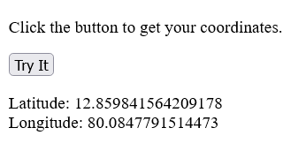
else {
x.innerHTML = "Geolocation is not supported by this browser.";
}
}
function showPosition(position) {
x.innerHTML = "Latitude: " + position.coords.latitude +
"<br>Longitude: " + position.coords.longitude;
}
</script>
</body>
</html>

Slide 91
Example explained:
Check if Geolocation is supported
If supported, run the getCurrentPosition() method. If not, display a message to the user
If the getCurrentPosition() method is successful, it returns a coordinates object to the function specified in the parameter (showPosition)
The showPosition() function outputs the Latitude and Longitude
The example above is a very basic Geolocation script, with no error handling.

Slide 92
Handling Errors and Rejections
The second parameter of the getCurrentPosition() method is used to handle errors. It specifies a function to run if it fails to get the user's location

Slide 93
function showError(error) {
switch(error.code) {
case error.PERMISSION_DENIED:
x.innerHTML = "User denied the request for Geolocation."
break;
case error.POSITION_UNAVAILABLE:
x.innerHTML = "Location information is unavailable."
break;
case error.TIMEOUT:
x.innerHTML = "The request to get user location timed out."
break;
case error.UNKNOWN_ERROR:
x.innerHTML = "An unknown error occurred."
break;
}
}

Slide 94
Location-specific Information
Geolocation is also very useful for location-specific information, like:
Up-to-date local information
Showing Points-of-interest near the user
Turn-by-turn navigation (GPS)

Slide 95
The getCurrentPosition() Method - Return Data
The getCurrentPosition() method returns an object on success. The latitude, longitude and accuracy properties are always returned. The other properties are returned if available:

Slide 96
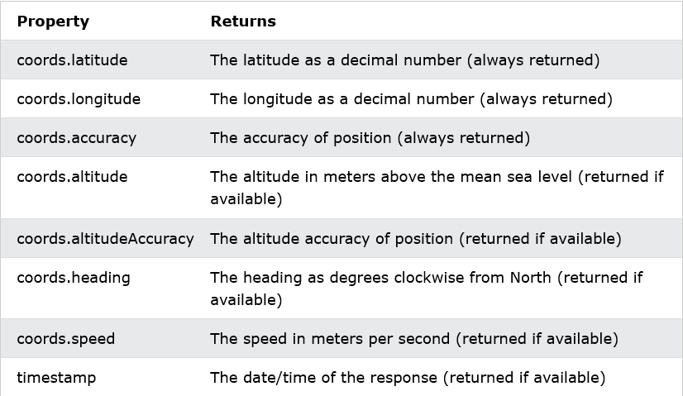

Slide 97
Geolocation Object - Other interesting Methods
The Geolocation object also has other interesting methods:
watchPosition() - Returns the current position of the user and continues to return updated position as the user moves (like the GPS in a car).
clearWatch() - Stops the watchPosition() method.
The example below shows the watchPosition() method. You need an accurate GPS device to test this (like smartphone):

Slide 98
<script>
var x = document.getElementById("demo");
function getLocation() {
if (navigator.geolocation) {
navigator.geolocation.watchPosition(showPosition);
} else {
x.innerHTML = "Geolocation is not supported by this browser.";
}
}
function showPosition(position) {
x.innerHTML = "Latitude: " + position.coords.latitude +
"<br>Longitude: " + position.coords.longitude;
}
</script>

